Slide 1
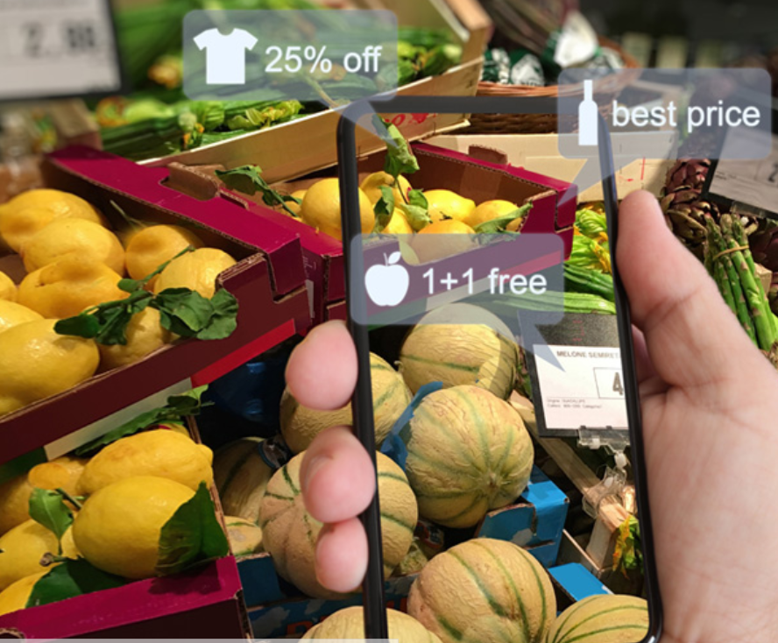
Image Preprocessing

Slide 2

Image Preprocessing Techniques

Slide 3
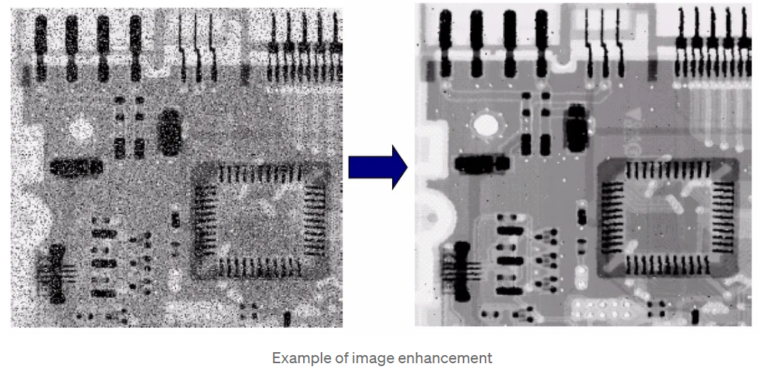
Image enhancement techniques
Used to improve the visual appearance of an image or to make certain features more distinguishable.
Making images more visually appealing.
Bringing out specific features.
Removing noise from images.
Highlighting interesting details in images.

Slide 4
Common image enhancement techniques
Histogram Equalization
Contrast Stretching
Smoothing
Sharpening
Noise Reduction
Edge Enhancement
Gamma Correction
Image Inversion
Bilateral Filtering
Color Enhancement
Morphological Operations

Slide 5
Understanding histograms
Image histogram:
Graphical representation of the distribution of pixel intensities in an image.
It plots the number of pixels (frequency) for each intensity value, typically ranging from 0 (black) to 255 (white) for 8-bit grayscale images.
Low contrast images:
In images with low contrast, the histogram is often clustered in a narrow range of intensity values.
This clustering results in an image where details are difficult to distinguish, as there is little variation in brightness.

Slide 6
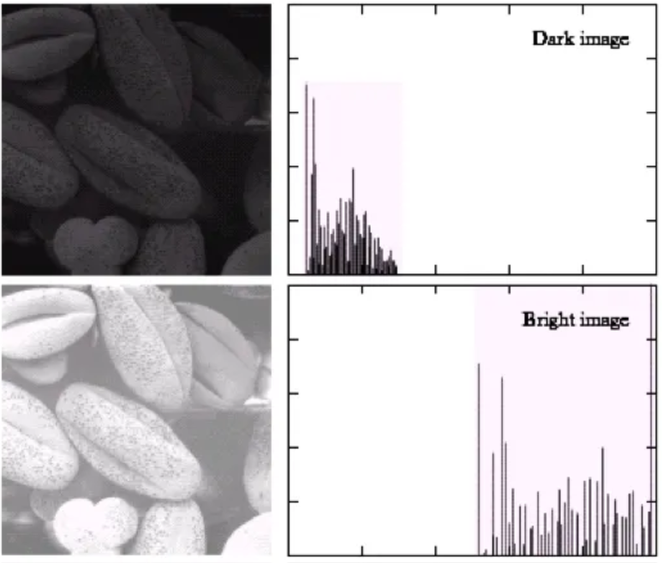
Histogram of dark and bright images

Slide 7
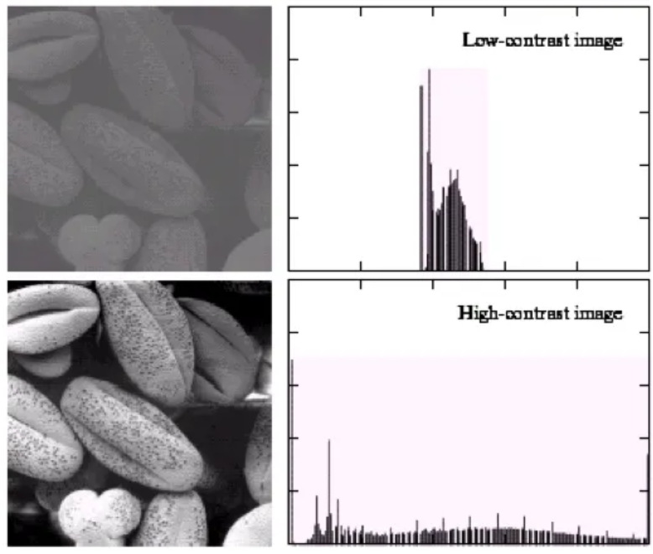
Histogram of low-contrast and high-contrast images

Slide 8
How Histogram Equalization Works
Calculation of Cumulative Distribution Function (CDF):
The CDF is a cumulative sum of the histogram values, which shows the cumulative probability of intensity values up to a certain level.
Mapping Intensities:
The CDF is then normalized to span the full intensity range of the image (e.g., 0 to 255 for an 8-bit image).
This normalization maps the original pixel intensities to new intensity values that are spread more evenly across the entire range.
Transforming the Image:
Finally, each pixel in the original image is transformed based on the normalized CDF.
The result is an image with a more uniform distribution of intensities, leading to improved contrast.

Slide 9
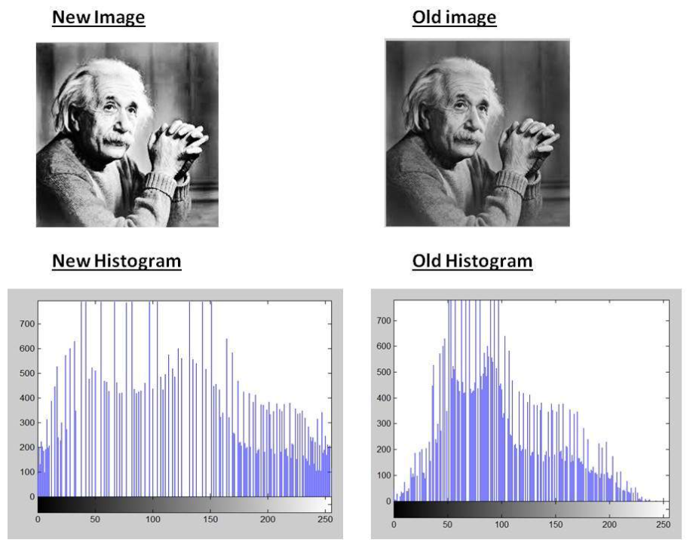
Comparison of images before and after histogram equalization

Slide 10
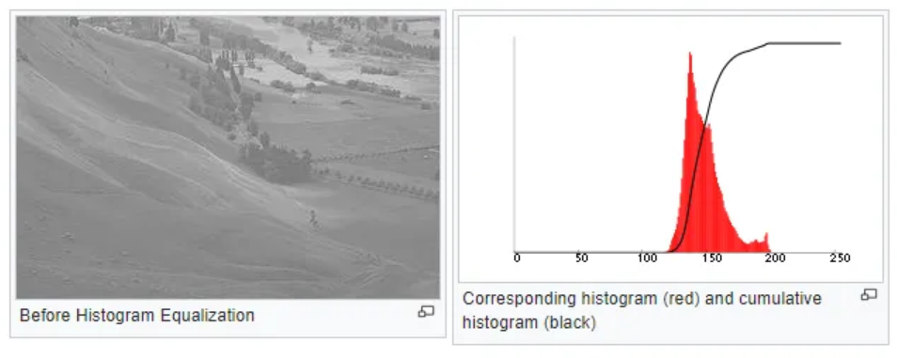
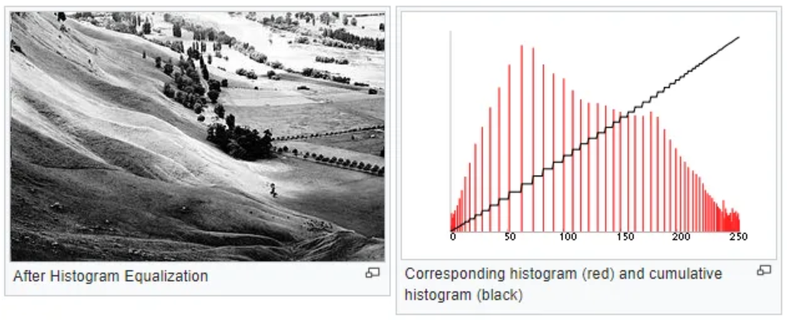
Comparison of images before and after histogram equalization

Slide 11
Comparison of images before and after histogram equalization
Histogram Before Equalization:
The histogram is narrow, showing a limited range of intensity values.
After Histogram Equalization:
The pixel intensities are spread out across the entire range, from 0 to 255.
The resulting image has higher contrast, making previously hidden details more visible.

Slide 12
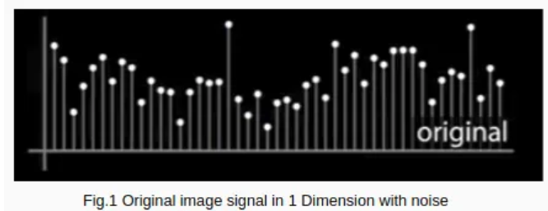
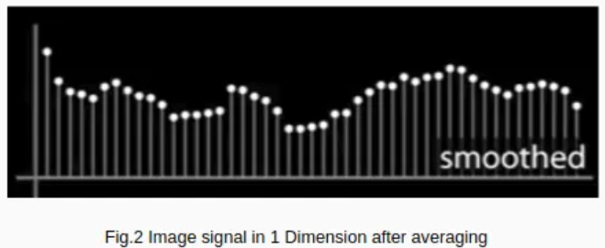
Noise Reduction
Techniques used to remove or minimize unwanted random variations in pixel intensity, known as noise, from an image.
Noise can be introduced during image acquisition, transmission, or processing, and it can degrade the quality of an image, making it difficult to interpret or analyze.

Slide 13
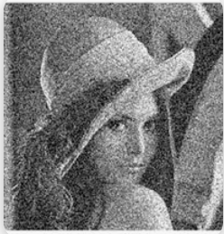
Types of Noise – Gaussian Noise
It is characterized by random variations in intensity that follow a bell curve distribution.
Appearance: Appears as fine, grainy variations in intensity across the image.
Source: Often caused by thermal noise in sensors or electronic interference.

Slide 14
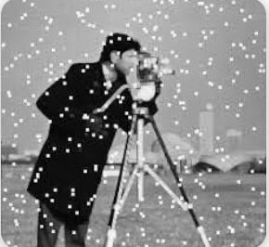
Types of Noise – Salt and Pepper Noise
Salt-and-pepper noise appears as random occurrences of black and white pixels in an image.
Appearance: The image is dotted with bright and dark spots.
Source: Typically caused by faulty pixels in camera sensors, bit errors in transmission, or image scanning.

Slide 15
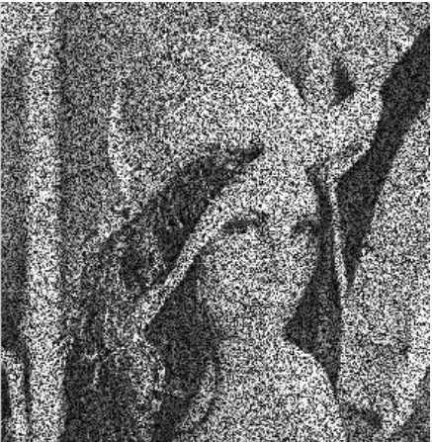
Types of Noise – Speckle Noise
A granular noise that typically occurs in coherent imaging systems, such as ultrasound or radar.
Appearance: The noise looks like granular spots that degrade image quality, especially in medical imaging.
Source: Caused by interference between multiple wavefronts.

Slide 16
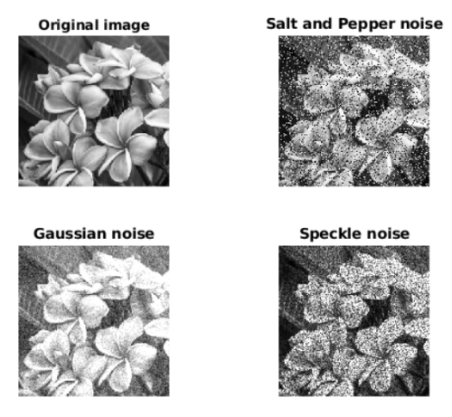
Noise Comparison

Slide 17
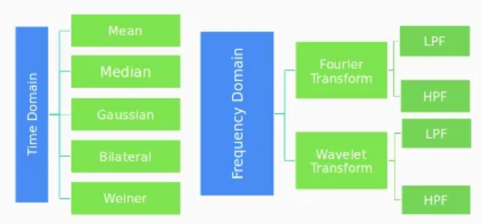
Noise reduction and filtering
Filtering image data is a standard process used in almost every image processing system.
Filters remove noise from images by preserving the details of the same.
Filters can be divided into two types : Time domain and Frequency domain

Slide 18
Gaussian Filter
A type of low-pass filter that uses a Gaussian function to weight the pixel values in the neighborhood.
Effect: Reduces Gaussian noise while preserving image structure better than the mean filter.
Application: Used in various applications, including photography, video processing, and computer vision, to reduce noise before further processing.

Slide 19
Code to apply Gaussian Filter
import cv2
from google.colab.patches import cv2_imshow
# Load noisy image
img = cv2.imread('/content/gauss.png')
# Apply Gaussian blur
# (kernel size must be odd, e.g., (5,5); larger kernel = stronger smoothing)
# cv2.GaussianBlur(src, ksize, sigmaX) where ksize is kernel size, sigmaX is standard
# deviation in X direction
denoised = cv2.GaussianBlur(img, (5, 5), 0)
# Show results
cv2_imshow(img) # Original noisy image
cv2_imshow(denoised) # Denoised image

Slide 20
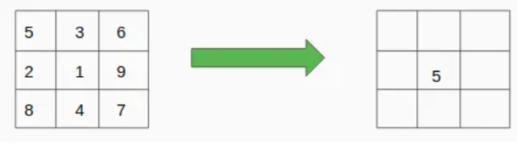
Mean Filter
Reduces noise by averaging the pixel values within a specified neighborhood. Each pixel is replaced by the mean of its neighboring pixels.
Effect: Effective at reducing Gaussian noise, but it can blur edges.
Application: Simple noise reduction in images where preserving edges is less critical.

Slide 21
Code to apply Mean Filter
import cv2
from google.colab.patches import cv2_imshow
# Load noisy image
img = cv2.imread('/content/image.png')
# Apply Mean filter (average blurring)
# (kernel size must be odd; larger kernel = stronger smoothing)
denoised = cv2.blur(img, (5, 5))
# Show results
cv2_imshow(img) # Original noisy image
cv2_imshow(denoised) # Denoised image

Slide 22
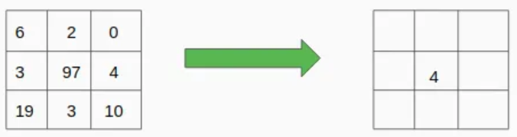
Median Filter
Reduces noise by replacing each pixel value with the median value of the pixels in its neighborhood.
Effect: Particularly effective against salt-and-pepper noise.
Application: Used in scenarios where edge preservation is important, such as in medical imaging or document processing.

Slide 23
Code to apply Median Filter
import cv2
from google.colab.patches import cv2_imshow
# Load noisy image
img = cv2.imread('/content/image.png')
# Apply Median filter
# Kernel size must be odd (3, 5, 7, ...)
denoised = cv2.medianBlur(img, 5)
# Show results
cv2_imshow(img) # Original noisy image
cv2_imshow(denoised) # Denoised image

Slide 24
Bilateral Filter
Reduces noise while preserving edges by considering both spatial proximity and intensity differences. It combines Gaussian filtering with edge preservation.
Effect: Reduces noise without blurring edges, making it ideal for images with important edge information.
Application: Commonly used in photography, medical imaging, and other fields where edge preservation is crucial.

Slide 25
Code to apply Bilateral Filter
import cv2
from google.colab.patches import cv2_imshow
# Load noisy image
img = cv2.imread('/content/img.png')
# Apply Bilateral Filter
# Parameters: (image, diameter, sigmaColor, sigmaSpace)
denoised = cv2.bilateralFilter(img, d=9, sigmaColor=75, sigmaSpace=75)
# Show results
cv2_imshow(img) # Original noisy image
cv2_imshow(denoised) # Denoised image

Slide 26
Wiener Filter
An adaptive filter that minimizes the mean square error between the estimated and true image. It is particularly useful in reducing additive noise.
Effect: Particularly useful in reducing additive noise.
Application: Often used in image restoration, especially in the presence of Gaussian noise.

Slide 27
Code to apply Wiener Filter
import cv2
import numpy as np
from scipy.signal import wiener
from google.colab.patches import cv2_imshow
# Load noisy image (grayscale for Wiener filter)
img = cv2.imread('/content/image.png', cv2.IMREAD_GRAYSCALE)
# Apply Wiener filter
# mysize = window size, defaults to (3, 3) if not specified
denoised = wiener(img, mysize=(5, 5))
# Convert back to uint8 for display (Wiener output is float64)
denoised = np.uint8(np.clip(denoised, 0, 255))
# Show results
cv2_imshow(img) # Original noisy image
cv2_imshow(denoised) # Denoised image using Wiener filter

Slide 28
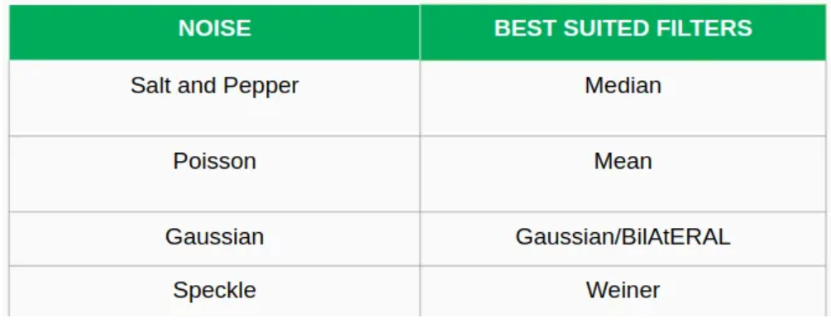
Best suited filters for noise

Slide 29
Image Sharpening
A technique used to enhance the edges and fine details in an image, making them more distinct and clearer.
The sharpened image is that in which the edges are clearly distinguishable by the viewer.
Usually, the intensity and contrast change at the edge. If this change is significant then the image is said to be sharp. The viewer can clearly see the background and foreground parts.

Slide 30
Common Sharpening Techniques
Unsharp Masking
Laplacian Filter
High-Pass Filter
Gradient-based methods (Sobel, Prewitt, Roberts)
Notes:
Complete the slides related to this

Slide 31
Laplacian Filter
Used in image sharpening to enhance the edges and fine details by emphasizing regions of rapid intensity change (such as edges).
It works by highlighting the parts of the image where the intensity values change the most, which typically occur at object boundaries or transitions between different textures.
Laplacian filter is a second-order derivative filter that calculates the rate of change in intensity in all directions (x and y).

Slide 32
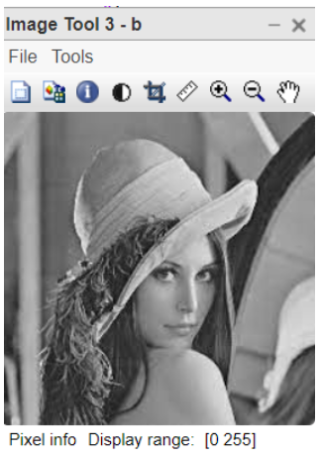
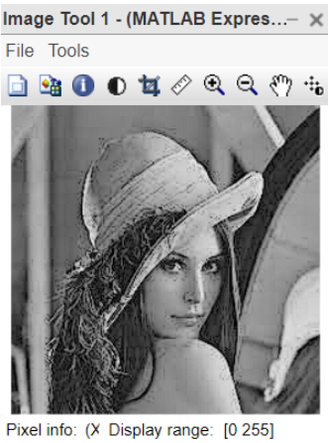
Effects of Laplacian Filter
Edge Enhancement: The Laplacian filter enhances edges by amplifying the high-frequency components in the image.
Improved Clarity: Adding the Laplacian result to the original image increases the contrast around edges, making details and transitions between different regions clearer.

Slide 33
High-Pass Filter
An image processing technique used to enhance the sharpness of an image by allowing high-frequency components (such as edges and fine details) to pass through while attenuating the low-frequency components (smooth or uniform regions).
This makes the high-pass filter particularly useful for edge detection and image sharpening.

Slide 34
Working of High-Pass Filter
High Frequencies (Edges and Fine Details):
High-frequency components correspond to areas in the image where there is a rapid change in intensity, such as edges or textures.
Low Frequencies (Smooth Areas):
Low-frequency components correspond to smooth or gradually varying areas of the image, such as backgrounds or large uniform regions.
A high-pass filter emphasizes the high-frequency components (edges and fine details) and suppresses the low-frequency components (smooth areas), making the image sharper.

Slide 35
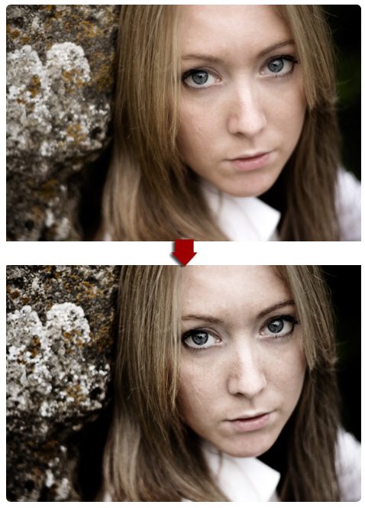
Effects of High-Pass Filter

